Slide 1

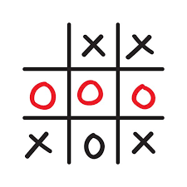
TIC-TAC-TOE game on Python This project & presentation is for partial fulfilment of Problem solving using Python (CS22001) Session 2022-2023 BY G-10 Team-4 Lovisha Goyal(2210991859) Lavisha(2210991852)[LEADER] Liza(2210991853) Supervisor Dr. Sanjoy Kumar Debnath Institute of Engineering and Technology Department of Computer Science and Engineering Chitkara University, Punjab, India

Slide 2

OUTLINE
INTRODUCTION/BACKGROUND
AIM AND OBJECTIVE
METHODOLOGY
RESULT AND ANALYSIS
LIMITATION OF THE PROJECT
CONCLUSIONS
RECOMMANDATIONS
REFERENCE
APPENDIX

Slide 3

INTRODUCTION
TIC-TAC-TOE is a very popular game, so let’s implement an automatic tic-tac-toe game using python.
Python is a high level , general purpose dynamic programming language that focus on code readibility. It is used in biggest organizations.
Our presentation is to implement the TIC-TAC-TOE game which feature like single and double player modes. In single player we use game theory logics like minimax algorithms to determine the best move that the computer plays .

Slide 4

OBJECTIVE
TIC-TAC-TOE game is very easy game which is mostly played among children and also helps to improve their concentration.
The main objective of this project is to build tic-tac-toe game so you can play it without wasting paper and improve your concentration. To build it we use thinker module concept of python.
To play this game we need two players one is “X” and other is “O”. To win the game players have to get 3 marks in a row(up , down , across, or diagonally).

Slide 5

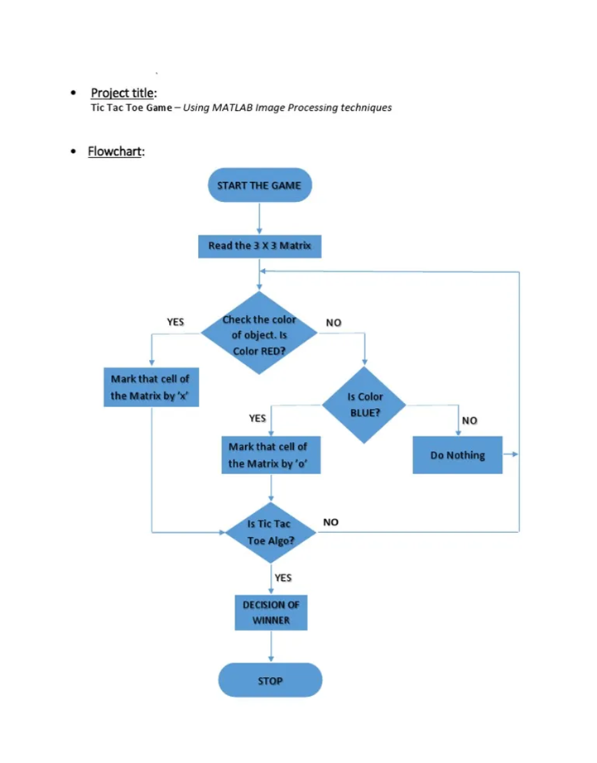
METHODOLOGY

Slide 6

RESULT AND ANALYSIS
The Tic Tac Toe game is a game for two players, called "X" and "O", who take turns marking the spaces in a 3×3 grid. The player who succeeded in placing three respective marks in a horizontal, vertical, or diagonal row wins the game.

Slide 7
LIMITATIONS
1. It can get boring knowing that you are going to win every single time.
2. When you know how to win, the game isn’t very challenging.
3. It can get boring if the game ends in a tie.
4. If you’re new to the game, you could be taken advantage of by players who know the game’s winning strategies.

Slide 8
CONCLUSION
TIC-TAC-TOE is most familiar among all the age groups. Intelligence can be a property of any purpose-driven decision maker. This basic idea has been suggested many times. An algorithm of playing tic-tac-toe has been presented and tested that works in efficient way. Overall the system works without any bugs.

Slide 9
RECOMMENDATIONS
Playing Tic-Tac-Toe may seem like a game of chance at first, but after playing a few rounds, players usually notice that there’s a certain strategy and pattern of movements that can end up in a win. Simple moves that are quite logical are the ones that result in win. Players need to focus or concentrate for a few moments at a time.

Slide 10
REFERENCE
Books:
H.M Deitel and P.J Deitel, Java
Site:
studo.com
www.toyheater.com

Slide 11
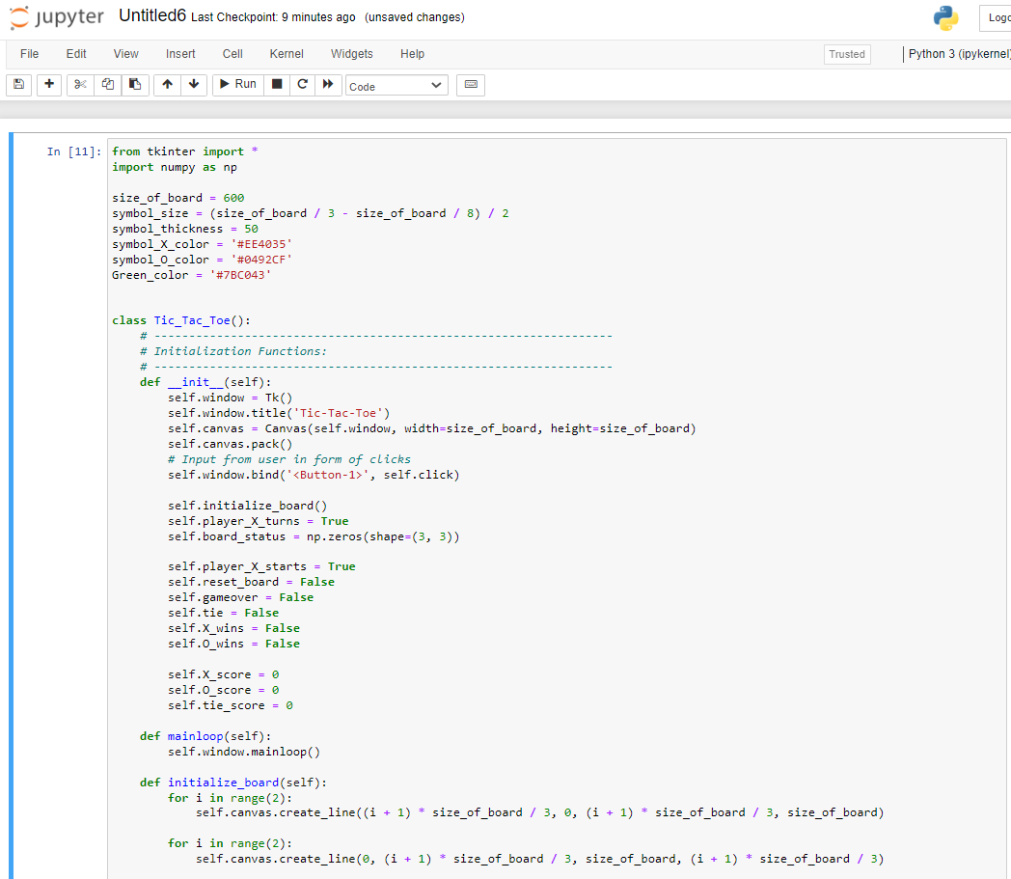
APPENDIX

Slide 12
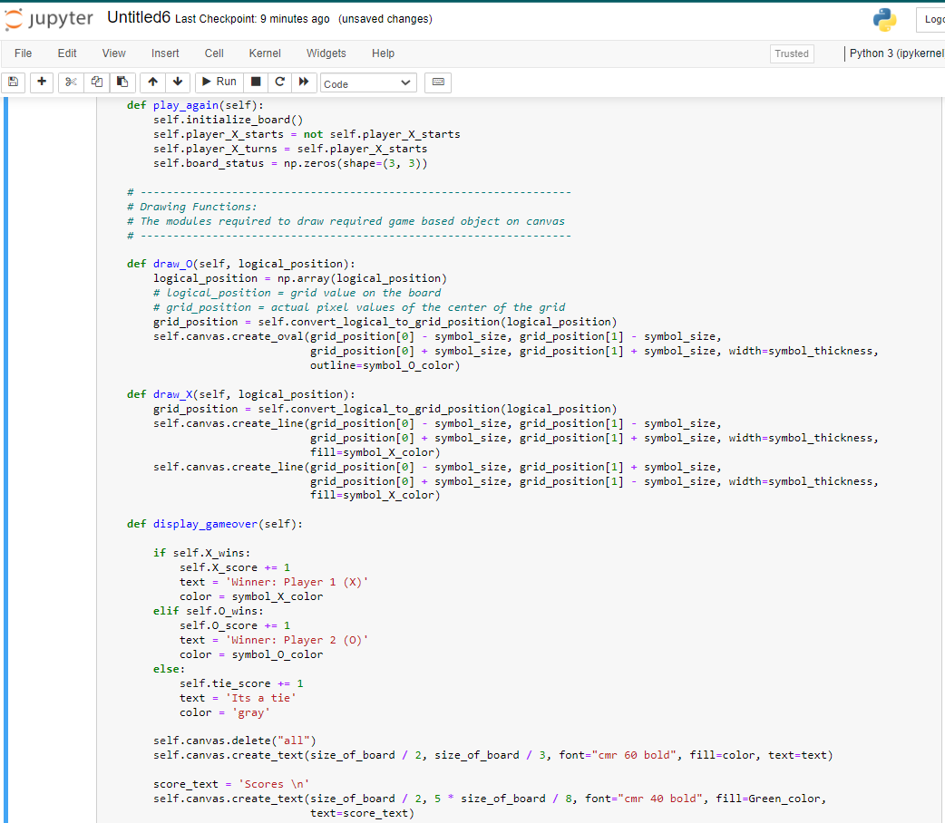
APPENDIX

Slide 13
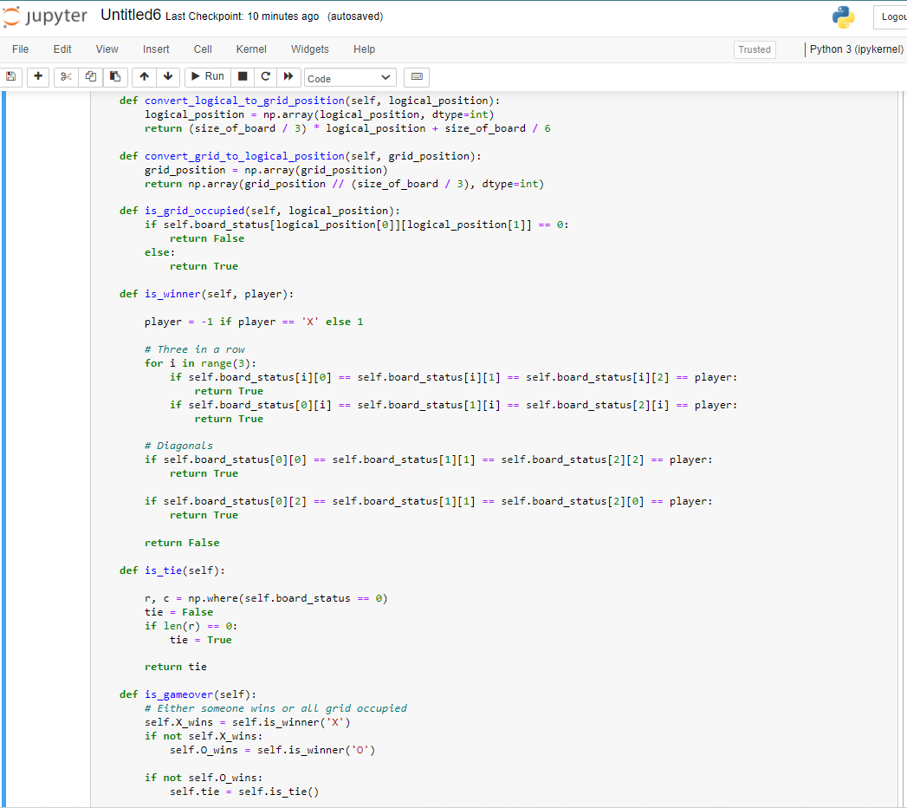
APPENDIX

Slide 14
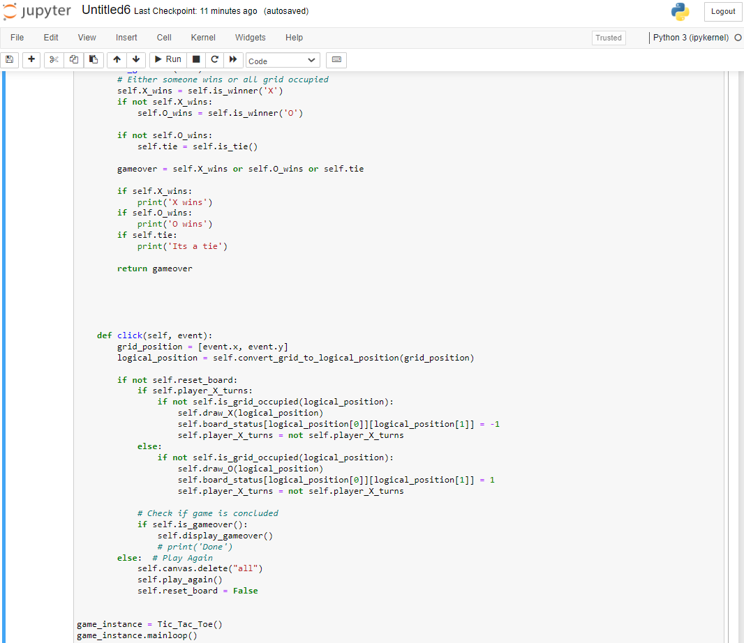
APPENDIX

